Slide 1
Covid ETL
Soumya Kinger
Zachary Cohen
Kayla Fennell

Slide 2
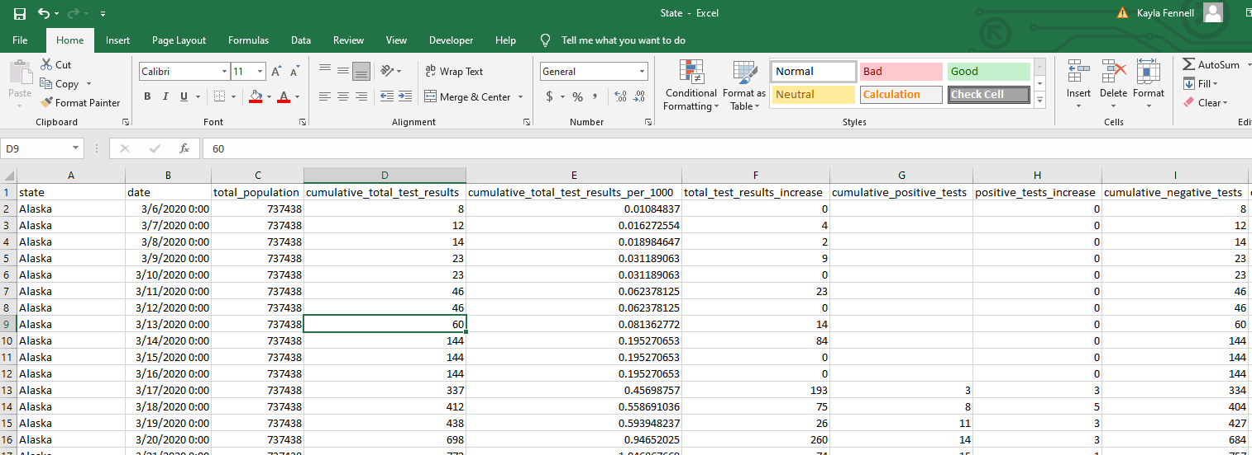
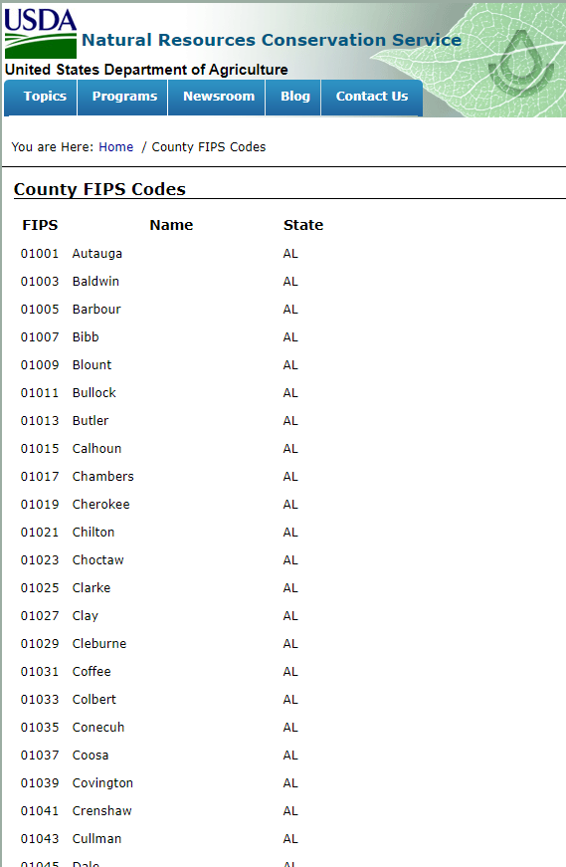
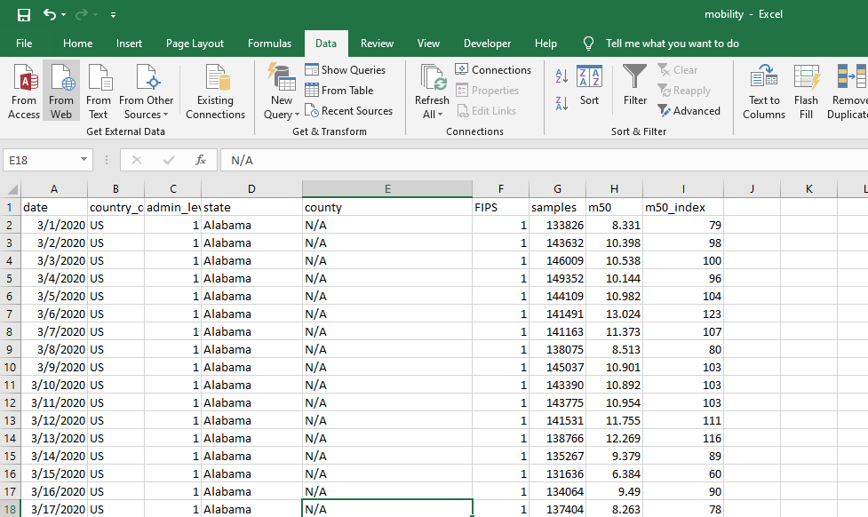
Extraction
Data Sources
Data World
USDA
Kaggle
Notes:
Discuss each site, the data source we used from it, and the data type
How much data
Discuss review of Data before cleaning or the “pre-cleaning” process to how the data from each source needs to be cleaned.
Identify columns needed, not needed, and name variations
Did we need to clean any numbers or any calculations?

Slide 3
Transformation
State Dataset
County Dataset
FIPS Website
Air Traffic Dataset
# Web scraping of FIPS code
url = 'https://www.nrcs.usda.gov/wps/portal/nrcs/detail/?cid=nrcs143_013696' browser.visit(url) html = browser.html #using beautiful soup, parse the html table to get state name, code and fips soup = BeautifulSoup(html, 'html.parser') tablerows = soup.find("table", class_="data").find("tbody").find_all("tr")staterow = [] allstates = []for row in tablerows: try: rowdata = row.find_all("td") for td in rowdata: staterow.append(td.text.strip()) allstates.append(staterow) staterow = [] except AttributeError as e: print(e) allstates.pop(0)
# Removing columns not needed for state df
state_data_new = state_data_df.iloc[:, [0, 1, 2, 3, 4, 5, 6, 7, 8, 9, 10, 11, 12]]
state_data_new.head()
# Renaming fields for state df
state_data_new = state_data_new.rename(columns={
'cumulative_total_test_results_per_1000': 'cumulative_total_test_results_percentage',
'cumulative_deaths_per_100_000': 'cumulative_deaths_percentage'
})
state_data_new.head()
Notes:
Next we have the transformation phase in order to prepare our data for the end target. To make sure we
#clean up the dataframe to get only the required column names airtraffic_df = airtraffic_df[["Date","AirportName","City","State","Country","PercentOfBaseline"]]
Call out any special types or extra steps with identifying keys/common names.

Slide 4
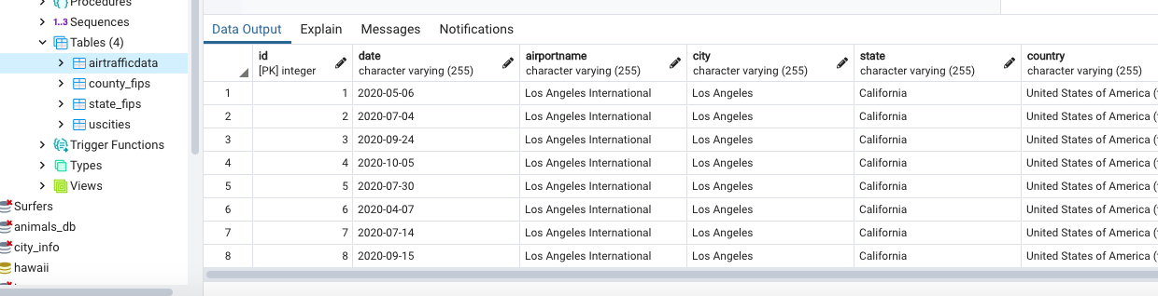
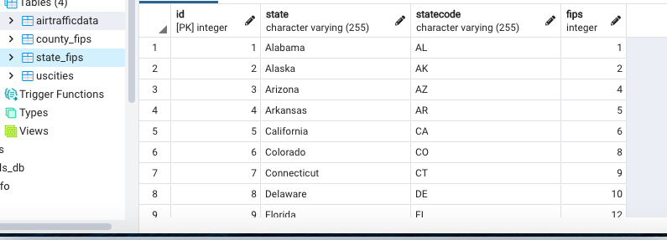
Loading
Jupyter Notebook Postgres
for i in range(len(allstates)):
currentrow = allstates[i]
currentstate = StateFips(state=currentrow[0],statecode = currentrow[1], fips = currentrow[2])
session.add(currentstate)
session.commit()
Notes:
Last, Coded databases to Postgres for storage

Slide 5

Any Questions?

